Slide 1
Stack in ARM – A Quick View
Shriram K Vasudevan

Slide 2
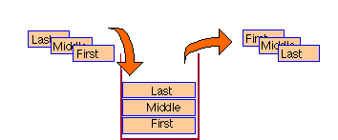
ARM and STACK
There are two instructions that come into play when someone talks on STACK in concurrence with ARM.
They are LDM and STM. They can be related to PUSH and POP of 8051.
LDM and STM are used for the purpose of storing and retrieving actions.
Stack is a memory area which can grow on addition of data to it and will obviously shrink when data is popped out of it.
POPPING will happen first for the lastly added data; simply saying it is nothing other than well known term called as LIFO, Last in First Out

Slide 3
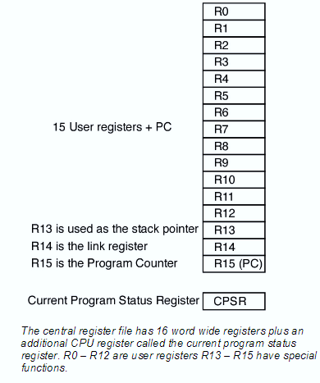
Contd.,
Well, the next terminology to know is the stack pointer. It is used to point the stack. In ARM there is no special register called as a stack pointer. (R13 is generally used)
But, instead it will be stored in any one of the available general purpose registers

Slide 4
Contd.,
One can use LDM / STM instructions to get the PUSH / POP done.
Also, there is a suffix to be added, to indicate, what type of stack we are gonna use.
The base register (SP – the one you choose) shall play a major role.
Also, remember this. LDM/STM can be used to do PUSH / POP for any number of registers (Unique) through a single instruction.

Slide 5
Contd.,
Several Stack Types are Supported, here!
The stack can be
Ascending or Descending.
The stack can grow downwards or upwards (Ascending or Descending) stack.
Full or Empty Stack.
The Stack pointer can be made to point the topmost item / or the next available free space. Former is called Full Stack and the latter is called an Empty stack.

Slide 6
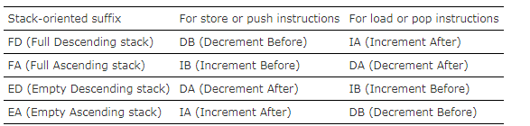
Contd.,
Refer the below table, which makes life easier.
With these suffixes, increment/decrement/before/after can be chosen.
STMFD sp!, {r0-r5} ; Push onto a Full Descending Stack
LDMFD sp!, {r0-r5} ; Pop from a Full Descending Stack

Slide 7
Contd.,

Slide 8
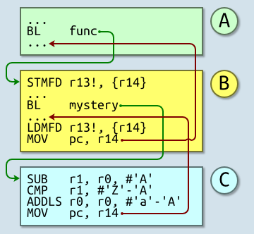
A Sample Call Chain – Stack Plays a Role!
Routine A branches with link (BL) to routine B.
The return address to be saved to the Link Register, which normally is R14.
Once Stored, the jump to new place can be initiated.
Routine B is going to call another subroutine, routine C.
To avoid overwriting R14, Stack comes to play.
R14 to be stored to the stack now.
It BL’s to routine C. (R14 ← return address, PC ← Routine C).
Routine C does its work, then returns using MOV pc,r14.
We return to Routine B after the BL instruction.
It restores R14 from the stack.
A return is effected and we end up at the instruction after the original BL.
Source: http://www.davespace.co.uk/arm/introduction-to-arm/chain.html

Slide 9

Contd.,
Stacking registers for nested subroutines
Stack operations are very useful at subroutine entry and exit.
At the start of a subroutine, any working registers required can be stored on the stack, and at exit they can be popped off again.
In addition, if the link register is pushed onto the stack at entry, additional subroutine calls can be made safely without causing the return address to be lost.
If you do this, you can also return from a subroutine by popping pc off the stack at exit, instead of popping lr and then moving that value into pc.
For example:

Slide 10
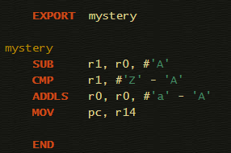
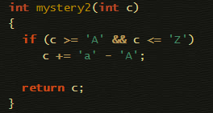
One question for you…
What does this code do?

